Slide 1


Global Climate Change
Week 1
Dr Thomas Bannan
Thomas.Bannan@Manchester.ac.uk

Slide 2

Today’s class
  Part 1: Course details (10 mins)
  Part 2: Overview of key concepts (60 mins)
  Part 3: Q/A (10 mins)

Slide 3
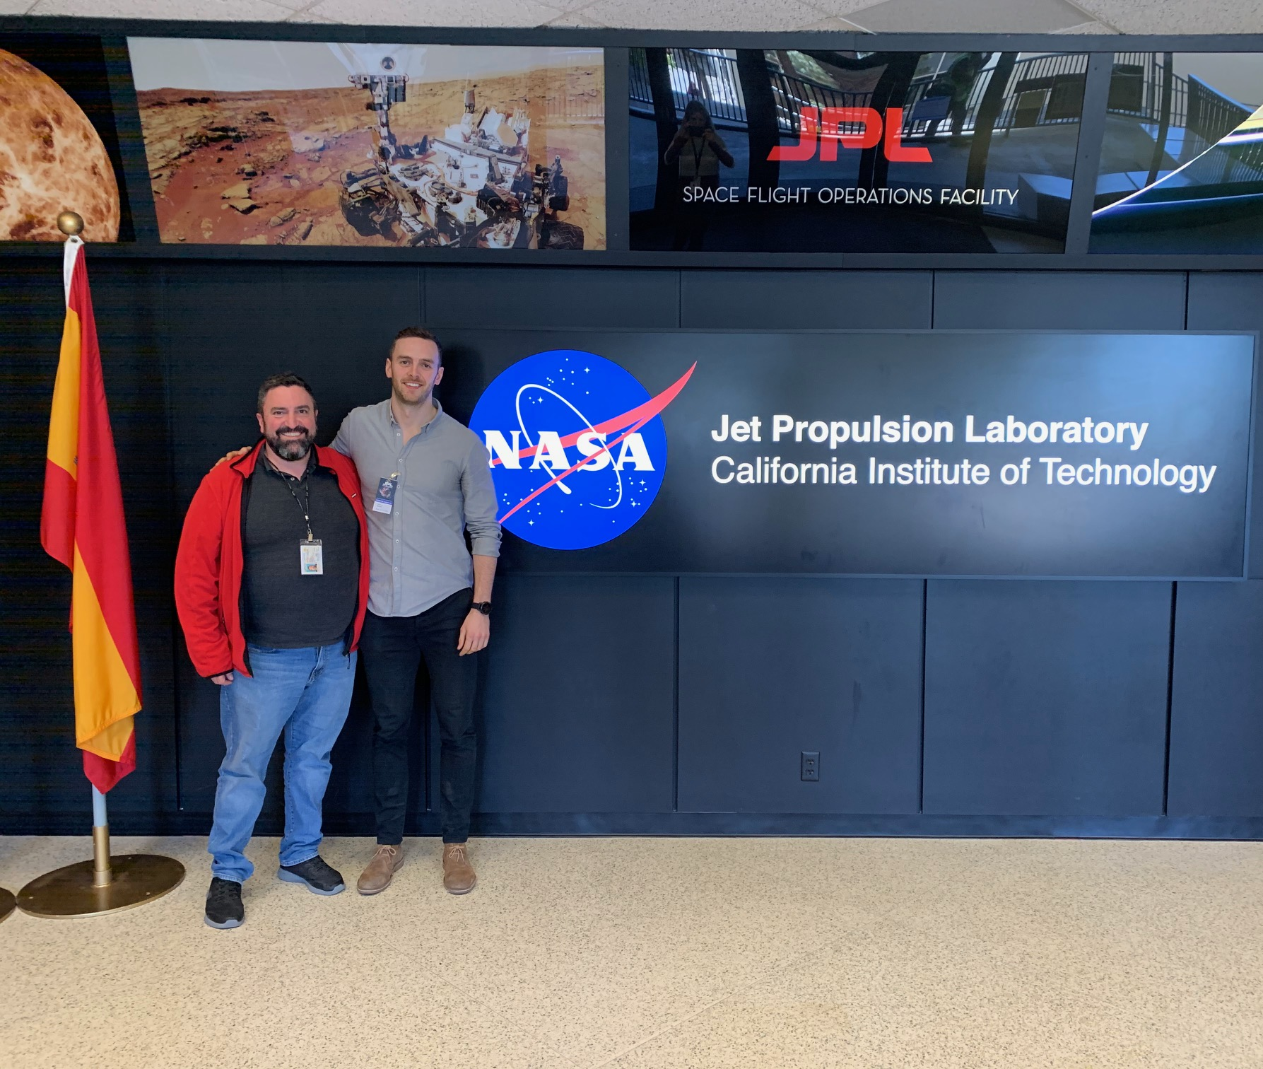
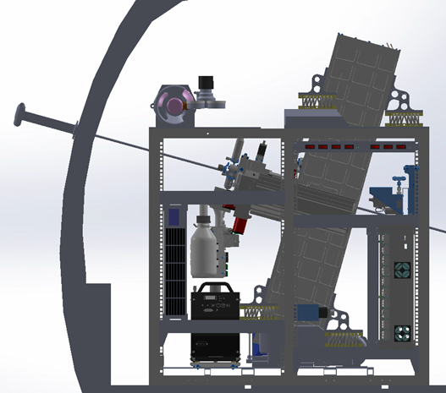
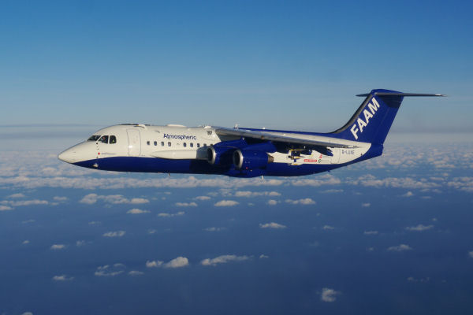
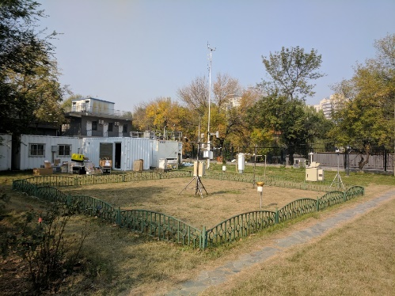
My Background
2009 - 2012 Environmental Science at UoM
2010 – Completed this course, taught by Prof Carl Percival
2011 - 3rd Year dissertation with Carl
2012 - Started PhD with Carl in Atmospherics
2015 – 2023 Research Fellow

Slide 4
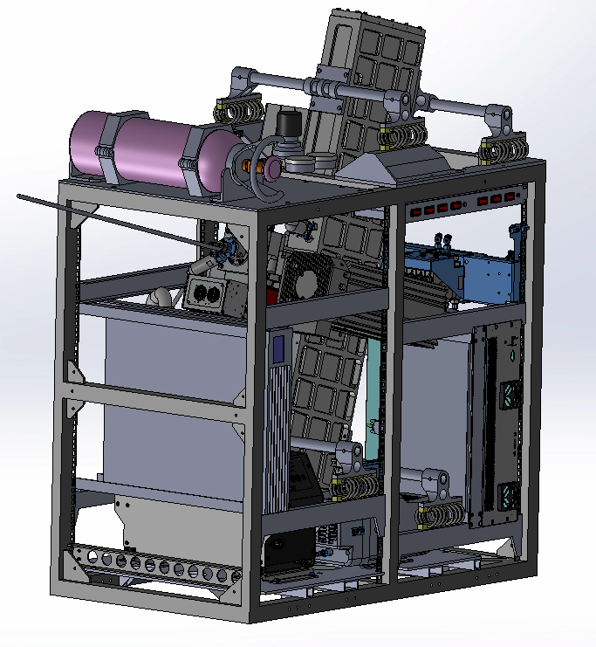
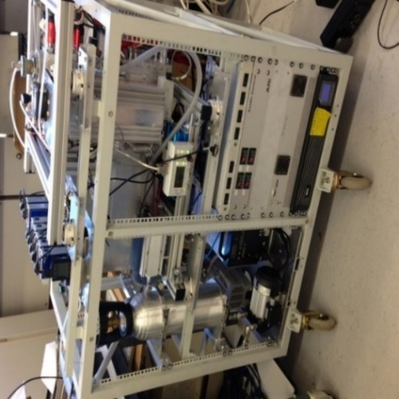
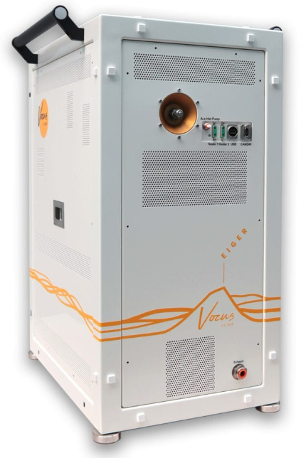
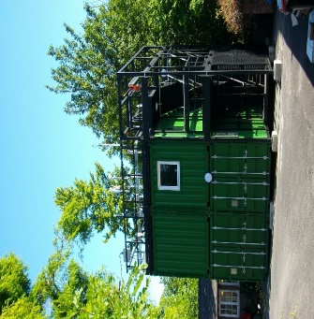
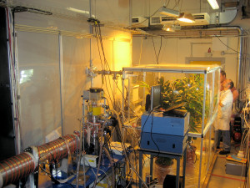


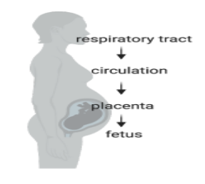

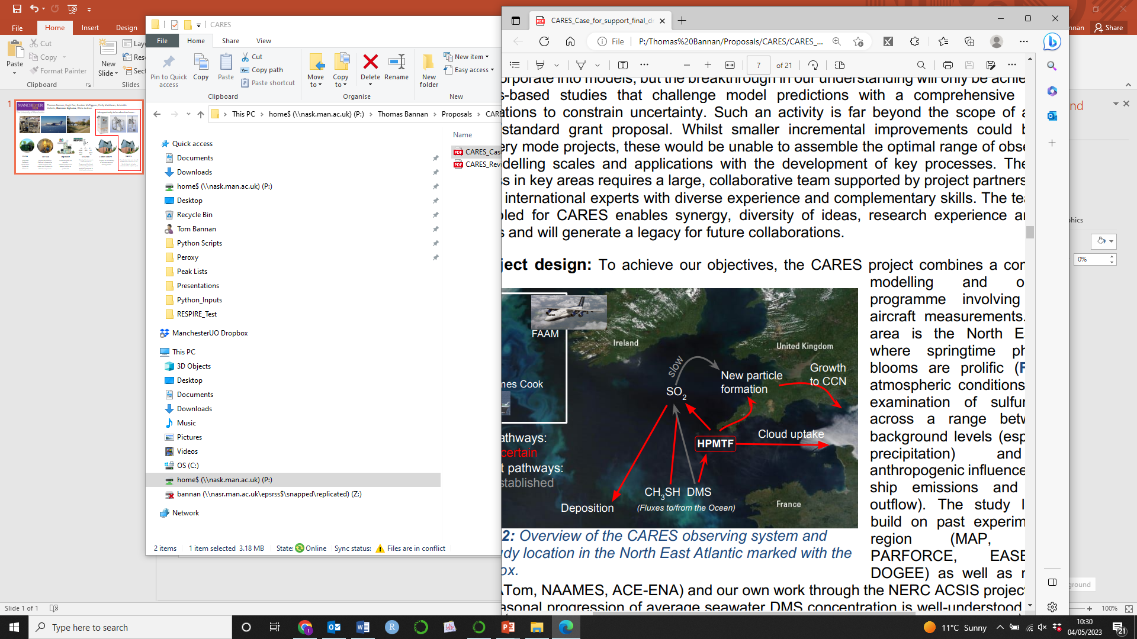
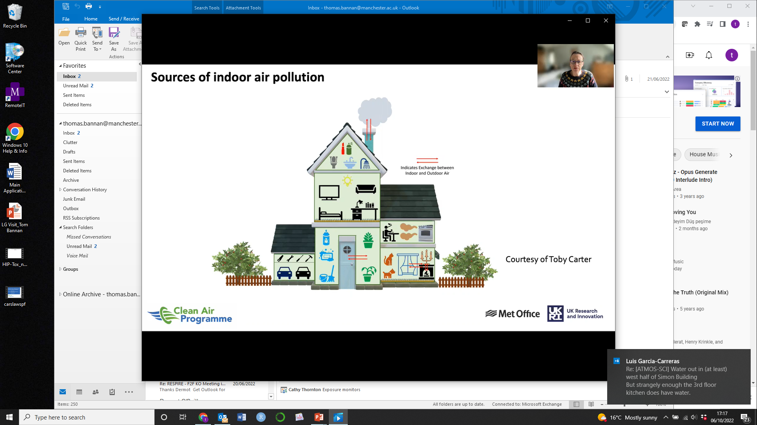
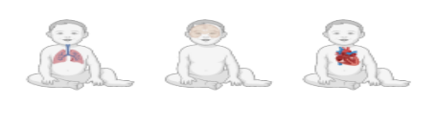
Some of my research…..
respiratory tract
CNS
CV System
OSCA
HIPTOX
Ingenious
RESPIRE
Future Homes
CARES
Integrated Research Observation System for Clean Air
Hazard Identification Platform to Assess the Health Impacts from Indoor and Outdoor Air Pollutant exposures
UnderstandING the sourcEs, traNsformations and fates of IndOor air pollUtantS
Relating Environment-use Scenarios in Pregnancy/Infanthood and Resulting airborne material Exposures to child health outcomes
Support for the delivery of net zero new and existing homes
Coordinated ship and aircraft CIMS measurements in the North Atlantic to better understand the sulphur cycle

Slide 5


Global Climate Change - 2026
Week 1 – Introduction to climate change and its impacts (5th Feb)
Week 2 – Natural Climate Variability (12th Feb)
Week 3 – Radiation Law/Greenhouse Effect/Radiative forcing/feedbacks (19th Feb)
Week 4 – Anthropogenic impacts (26th Feb)
Week 5 – The Evidence Base for Climate Change (5th March)
Week 6 – Mid Unit Test (10th March)
Week 7 – Climate Models (19th March)
Week 8 – Climate change adaptation (26th March)
Week 9 – Effects of Climate Change: Case Studies (23rd April)
Week 10 – Climate change Mitigation (30th April)
Week 11 – Revision Lecture (7th May)
Comments/Questions

Slide 6
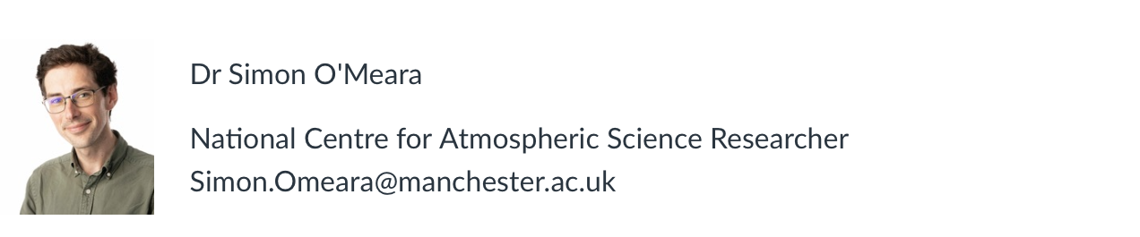
Guest Lecturer
WEEK 4

Slide 7
Global Climate Change
Assessment
Mid-semester Canvas Test [30%] – 10th March 2 pm
Summer Final Exam [70%]
UC for this course – Thomas.Bannan@manchester.ac.uk
WEEK 6

Slide 8
Global Climate Change - 2026
Week 6 – Mid Unit Test (10th March)
This assessment will test your understanding of weeks 1-5 of the Global Climate Change Course
The test must be completed and submitted in person under examination conditions.
When: Monday 10th March, 14:00–15:00/15:30
Where: Room 6.004, Simon Building – Computer Cluster/DASS Students - Mansfield Cooper 2.01 - this can change!!
Please arrive 10–15 minutes early so you have time to log in to Canvas before the test begins.
The test comprises 25 multiple choice questions. Only one submission is allowed per student (multiple attempts are not allowed). Submit using the 'Submit' button, but only do this when you are ready to finish the test as you cannot make repeat submissions.
For questions that are multiple answers (rather than multiple choice): Partial credit is calculated by dividing the total points possible by the number of correct answers for the question. This amount is awarded for each correct answer selected and deducted for each incorrect answer selected. No points are awarded or deducted for answers that are not selected. Zero is the lowest possible score.

Slide 9
Feedback

Slide 10
General Class Structure
  Part 1: Overview of key concepts (50 mins)
  Part 2: Break and Q/A (10 mins)
  Part 3: Workshop with exam style questions
  (50 mins)

Slide 11

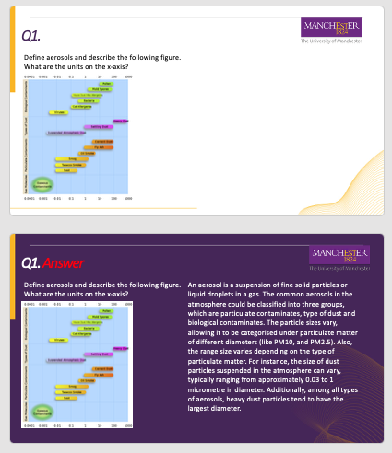
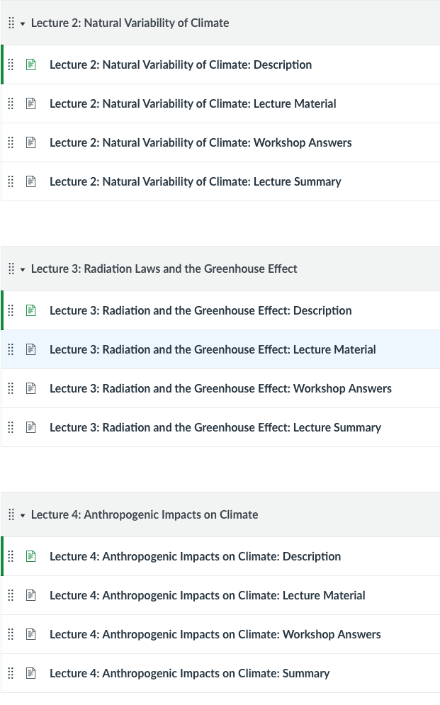
Lecture Structure
1 Hour Lecture
1 Hour Workshop
Canvas

Slide 12
What could I ask you in an exam? - Example
Define greenhouse gases and explain their role in global warming.
What are aerosols, and how do they influence the Earth's climate?
How does air pollution exacerbate the effects of climate change?
Explain the term "radiative forcing" and its relevance to climate science.
Describe how heatwaves influence the severity of air pollution.
Using examples, explain the difference between short-lived and long-lived climate forcers.
Analyse the role of anthropogenic activities in increasing the frequency of extreme weather events.
Interpret a graph showing CO₂ concentrations over the past century and discuss its implications.
Identify the main contributors to current warming trends.
If a country implements policies to reduce methane emissions, what immediate climate benefits might result?
Propose a strategy to simultaneously improve air quality and combat climate change.
How do deforestation and land-use changes contribute to global climate change?
Describe the feedback mechanisms in the climate system, such as the ice-albedo effect and the water vapour feedback.
Discuss the significance of the 1.5°C and 2°C warming thresholds for global climate policy and impacts.
Examine how global climate models (GCMs) are used to project future climate scenarios and their limitations.

Slide 13
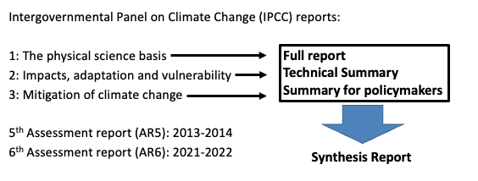
Reading List
IPCC website: https://www.ipcc.ch

Slide 14
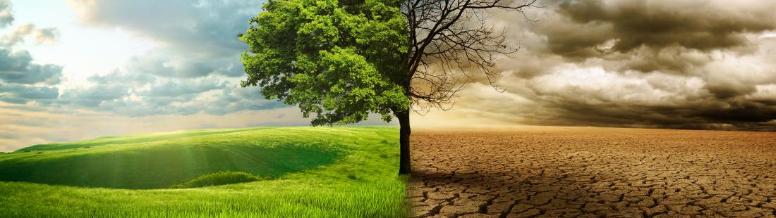
Intended Learning Outcomes
By the end of the week you will be able to:
Understand Climate Change Basics: Define and explain the key components of climate change, including the role of greenhouse gases, aerosols, and human activities.
Climate Change Impacts: Analyse how changes in climate influence weather extremes, such as heatwaves, droughts, and heavy precipitation.
Air Quality and Climate Interaction: Evaluate the relationship between air pollution and global climate change, including their impacts on health and ecosystems.

Slide 15
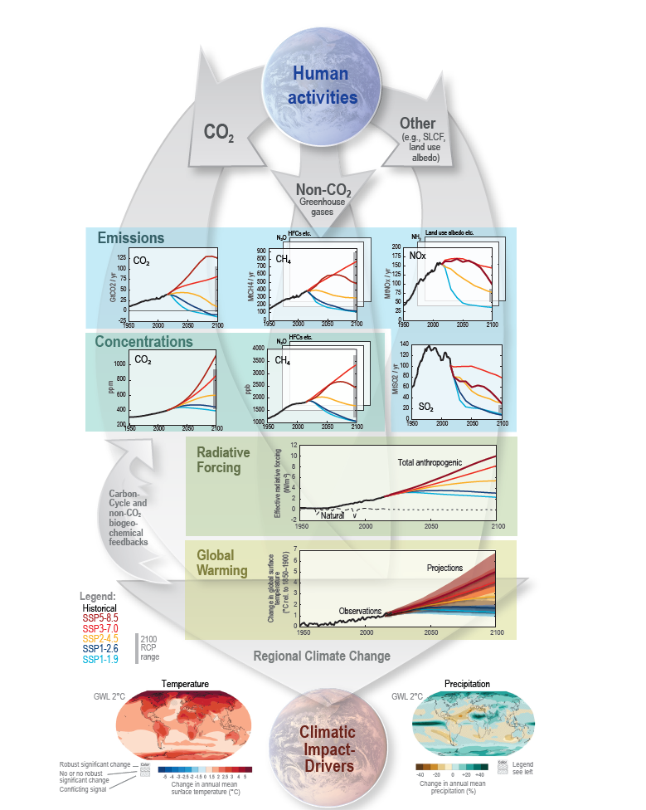
Week 1 – Climate Change and its Impacts
Week 2 – Natural Climate Variability
Week 3 – Radiation Law/Greenhouse Effect
Week 4 – Anthropogenic Impacts
Week 5 – The Evidence Base
Week 7 – Climate Models
Week 8 – Climate Change Adaptation
Week 9 – Effects of Climate Change
Week 10 – Climate Change Mitigation

Slide 16
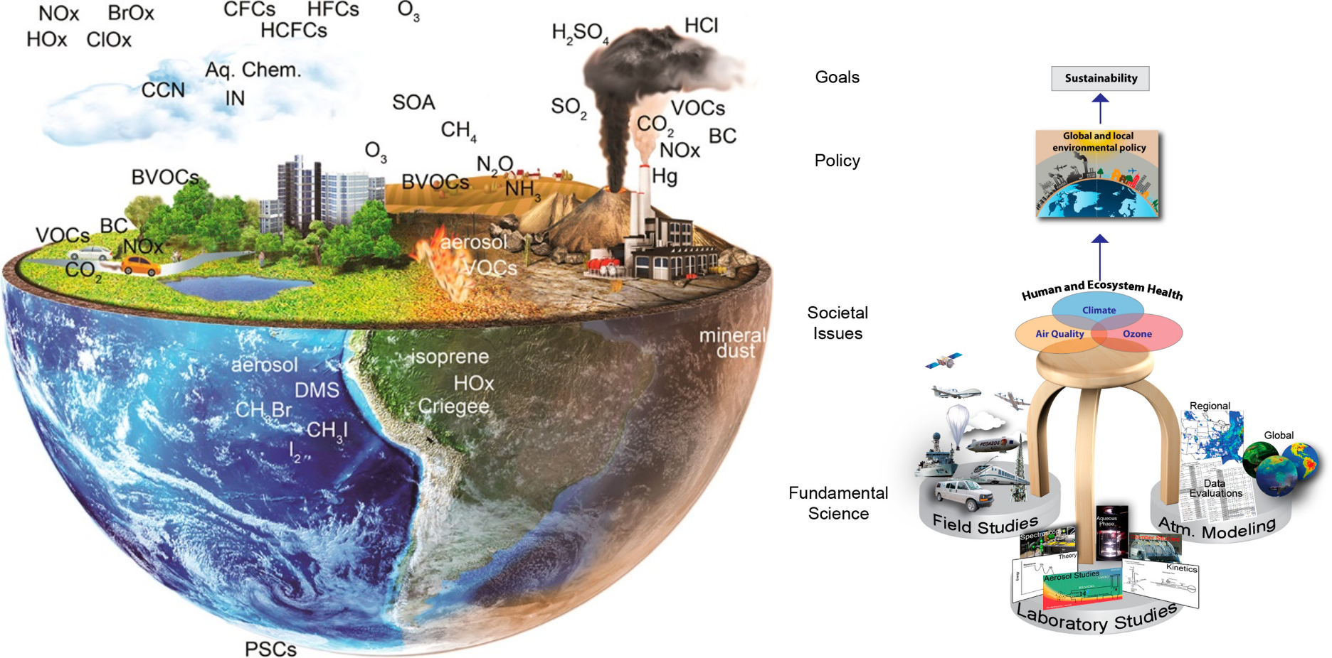

Slide 17
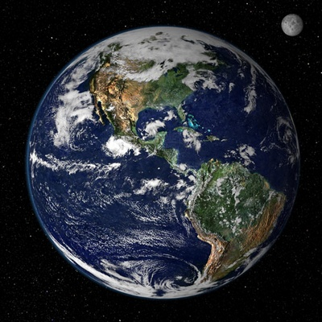
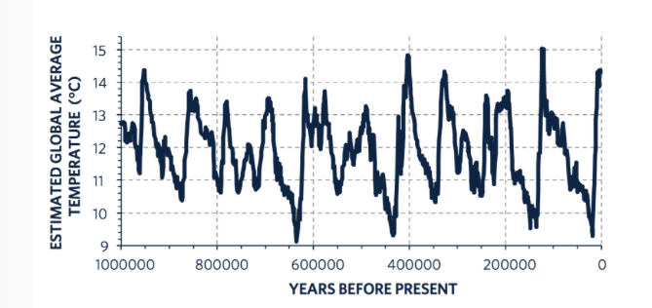
Natural Variability In Climate
WEEK 2 and 5

Slide 18
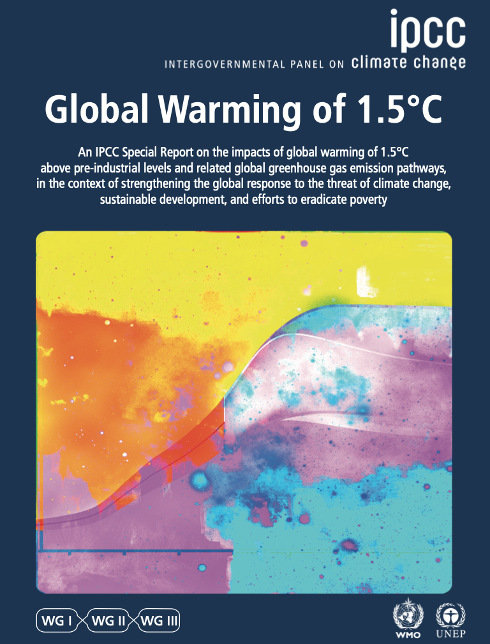
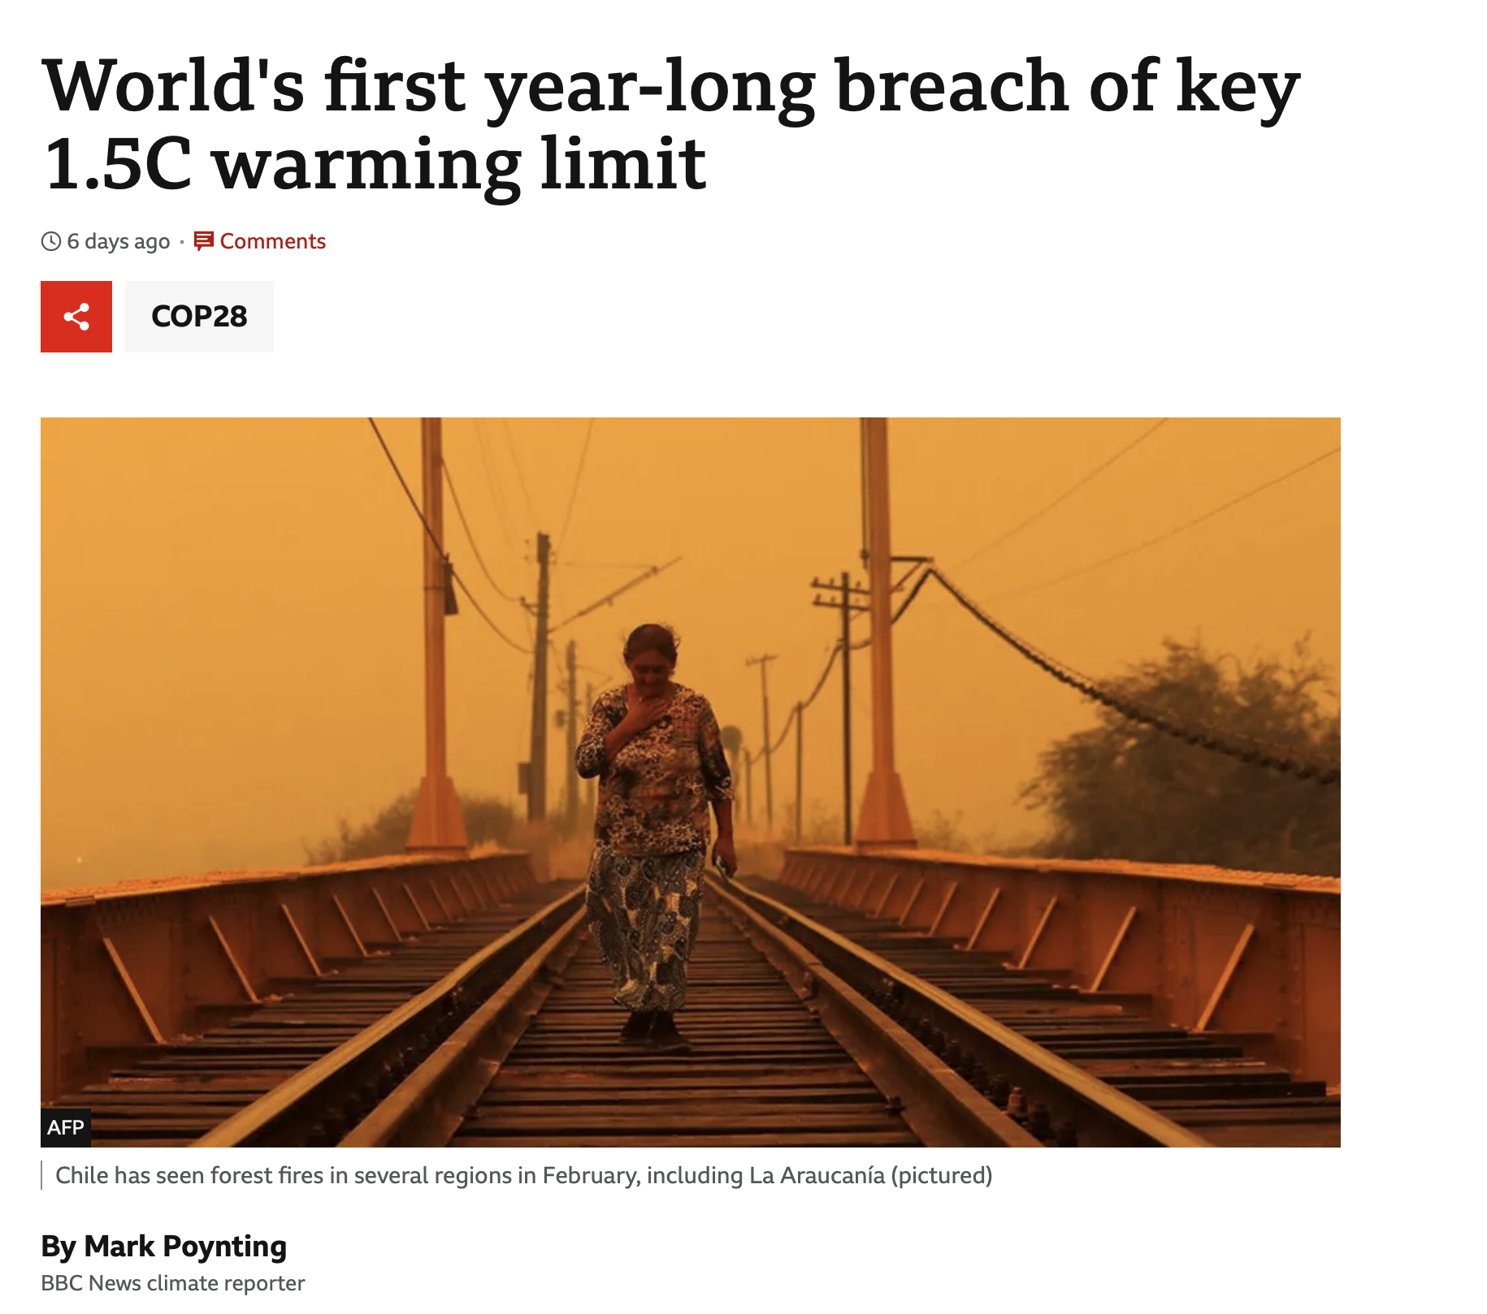
IPCC Special Report

Slide 19
IPCC Special Report – why 1.5ºC
Increased trends in intensity and frequency of some climate and weather extremes have been detected over time spans during which about 0.5°C of global warming occurred
Climate models project robust differences in regional climate between present-day and global warming up to 1.5°C and between 1.5°C and 2°C

Slide 20
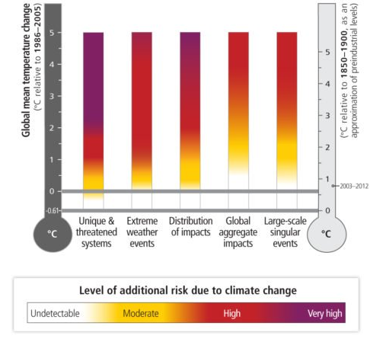
1.5⁰C doesn’t sounds like much, but…
Most recent ice age, 20,000 years ago
On average about 5°C cooler than Earth is today.
Canada and parts of northern Europe were completed covered with ice
Sea levels were about 120 meters lower than today

Slide 21
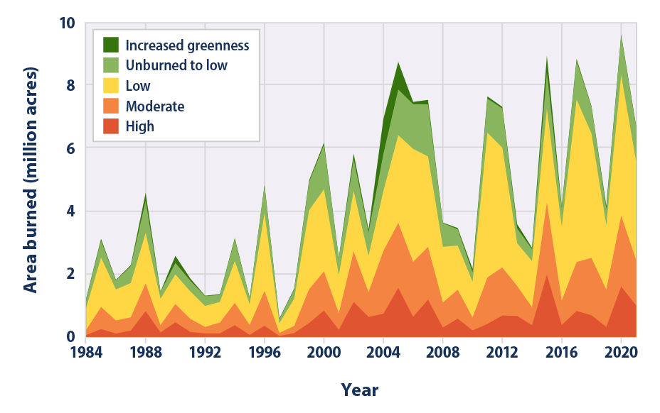
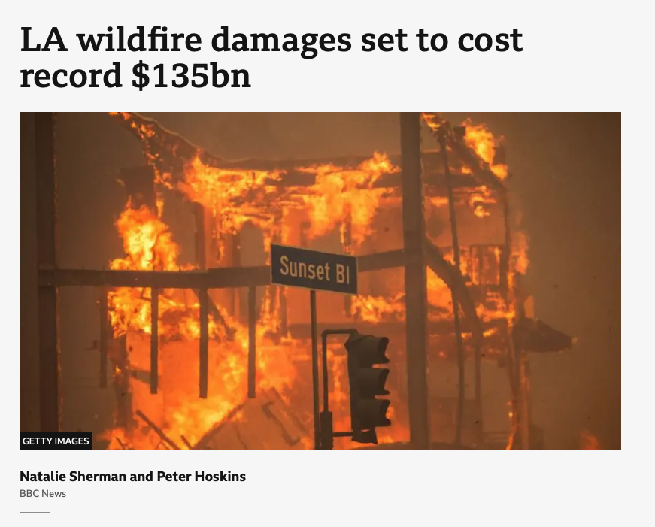
1.5⁰C doesn’t sounds like much, but…
Climate change has led to longer wildfire seasons, increased frequency, and larger burned areas.
Key drivers include warmer springs, longer summer dry seasons, drier soils, reduced snowpack, and earlier spring melting.
Increased temperatures and prolonged droughts are expected to intensify wildfire risk in the future.
Other contributing factors include land use, invasive species, and fire suppression practices.
WEEK 6

Slide 22
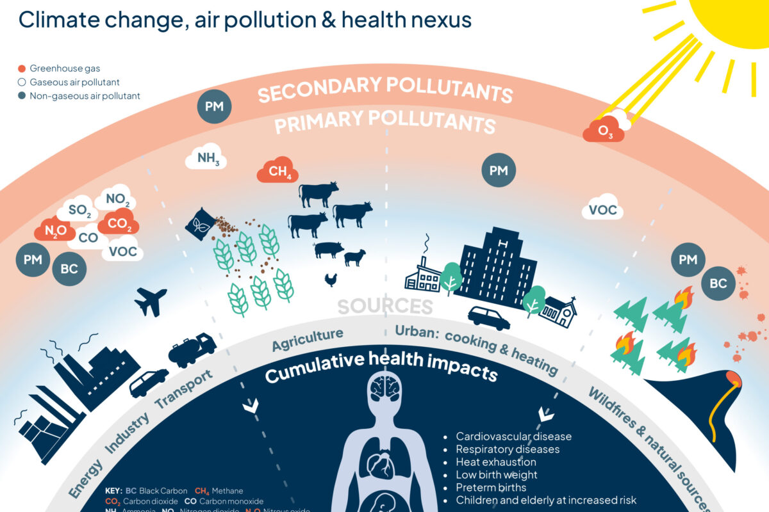
Climate Change Vs Air Quality
We know that air quality is important
We know that climate change is important
We know that these are largely talked about separately
There are significant benefits from tackling poor air quality and climate change in parallel
Like carbon dioxide (CO₂) and methane, air pollutants come from burning fossil fuels, whether from driving cars, generating electricity, or operating industrial plants.
The impacts of climate change exacerbate air pollution. For example, extreme heat increases the number of wildfires which, in turn, release more polluting gases and particulate matter into the atmosphere.
Extreme heat can increase pollution levels and exacerbates the health effects of breathing polluted air.
WEEK 9

Slide 23
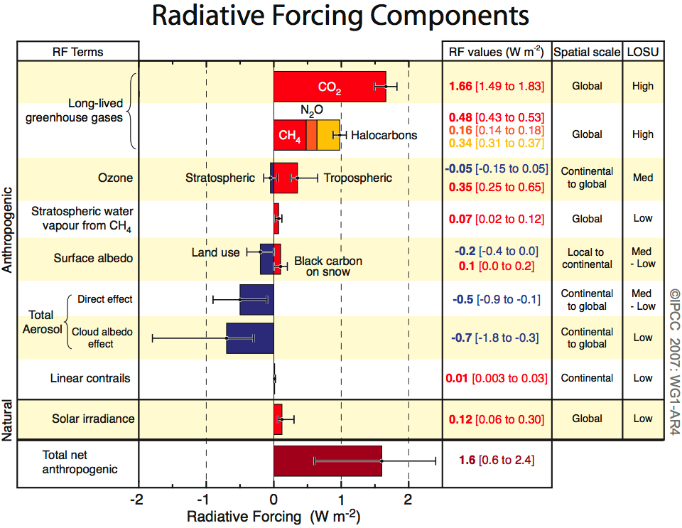
What are the key drivers of climate change?
WEEKS 2, 3, 4

Slide 24
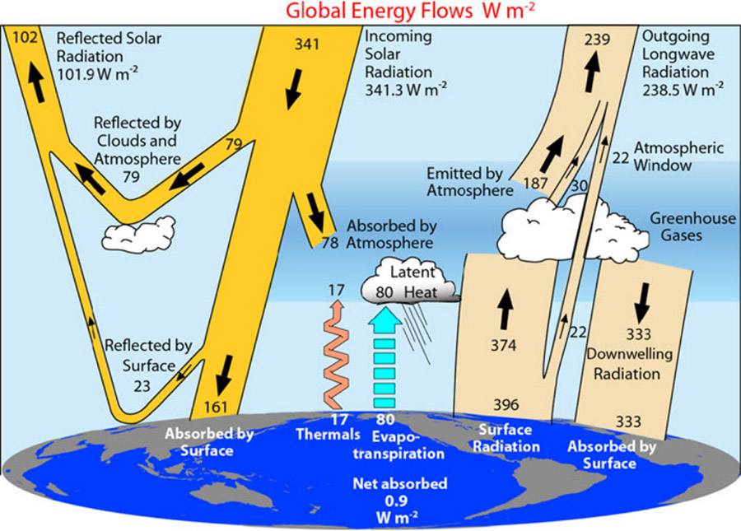
Energy in the Climate System

Slide 25
Energy in the Climate System
Solar radiation
high temp’ source
Short Waves
SPACE
Some of the infrared
radiation is absorbed
and re-emitted by the
greenhouse gases.
SUN
Some solar radiation is
reflected by the earth’s
surface, clouds and the atmosphere
This warms the surface and the atmosphere
Some solar radiation is absorbed by clouds and other gases
ATMOSPHERE
Terrestrial radiation
low temperature source
Long Waves
Most solar radiation
Passes straight through the atmosphere
and is absorbed to
warm the surface
EARTH
WEEK 3

Slide 26
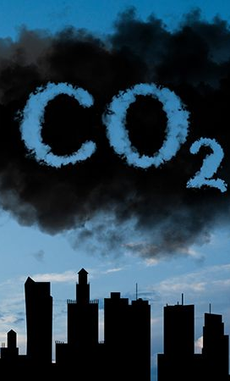
Measurements
CO₂
Direct measurements (1958 – present)
Ice cores (100’000s years ago)
Proxies (10s millions years ago)
Temperature
Direct measurements (from 1850) + satellites (from 1979)
Proxies:
  Tree rings (~500 – 2000 years)
  Oxygen isotopes in ice cores (100’000s years ago)
  Isotopes in lake and ocean sediments (millions of years)
The further back you go you get lower accuracy, but also lower temporal resolutions.
WEEK 5

Slide 27
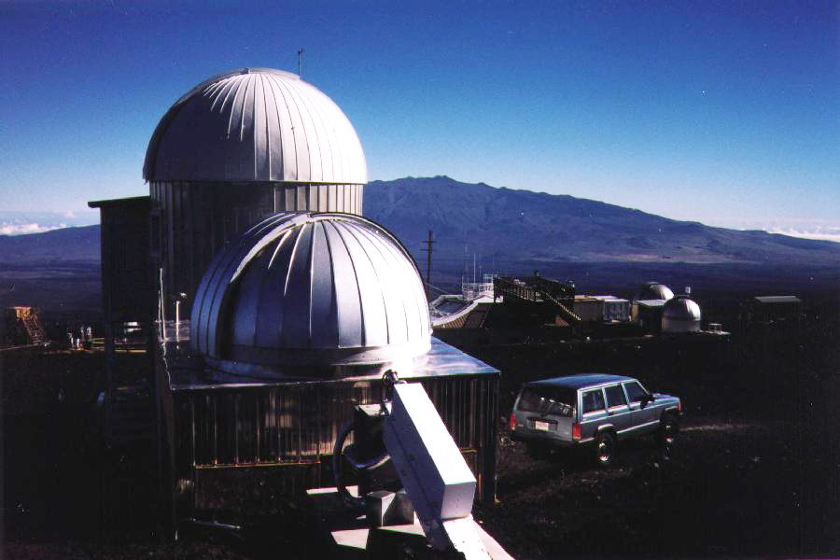
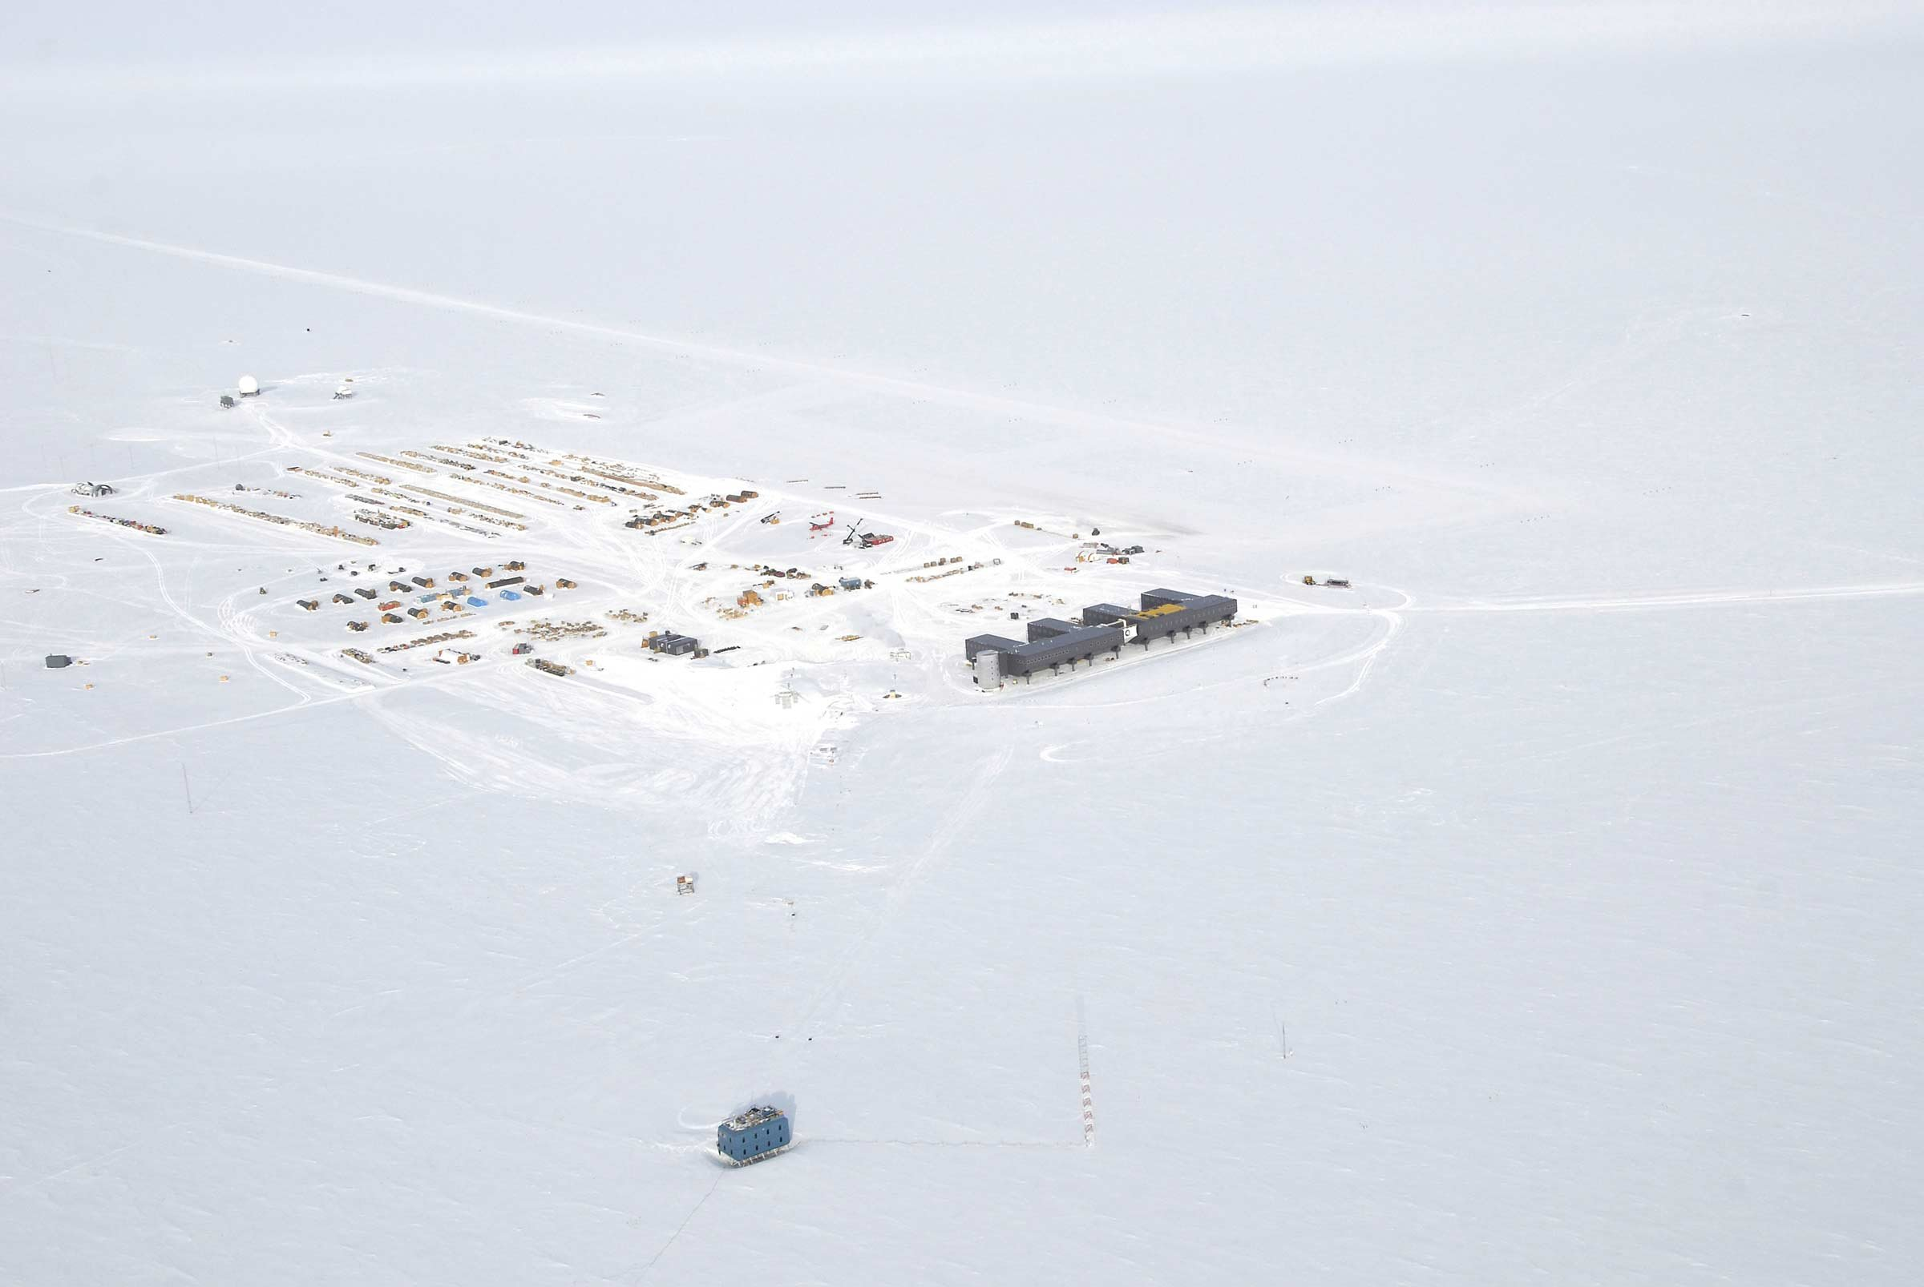
CO₂ Measurements
Mauna Loa Observatory (MLO)
South Pole Atmospheric Research Observatory (SPO)
Direct measurements (from 1958)

Slide 28
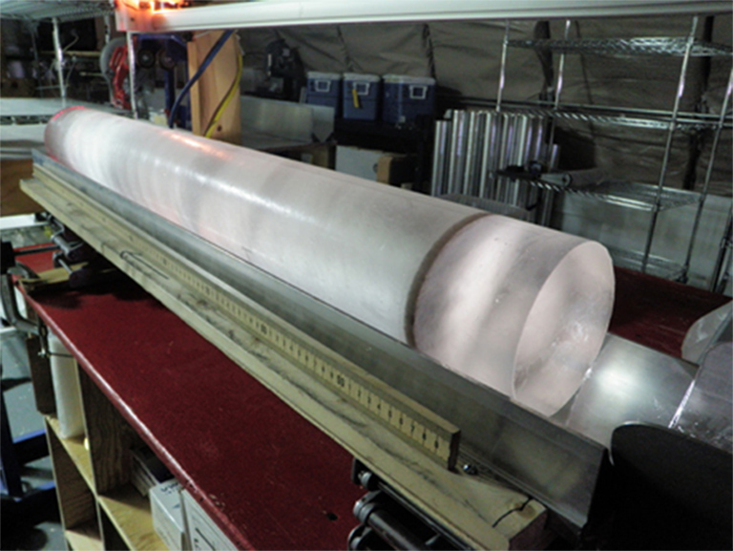
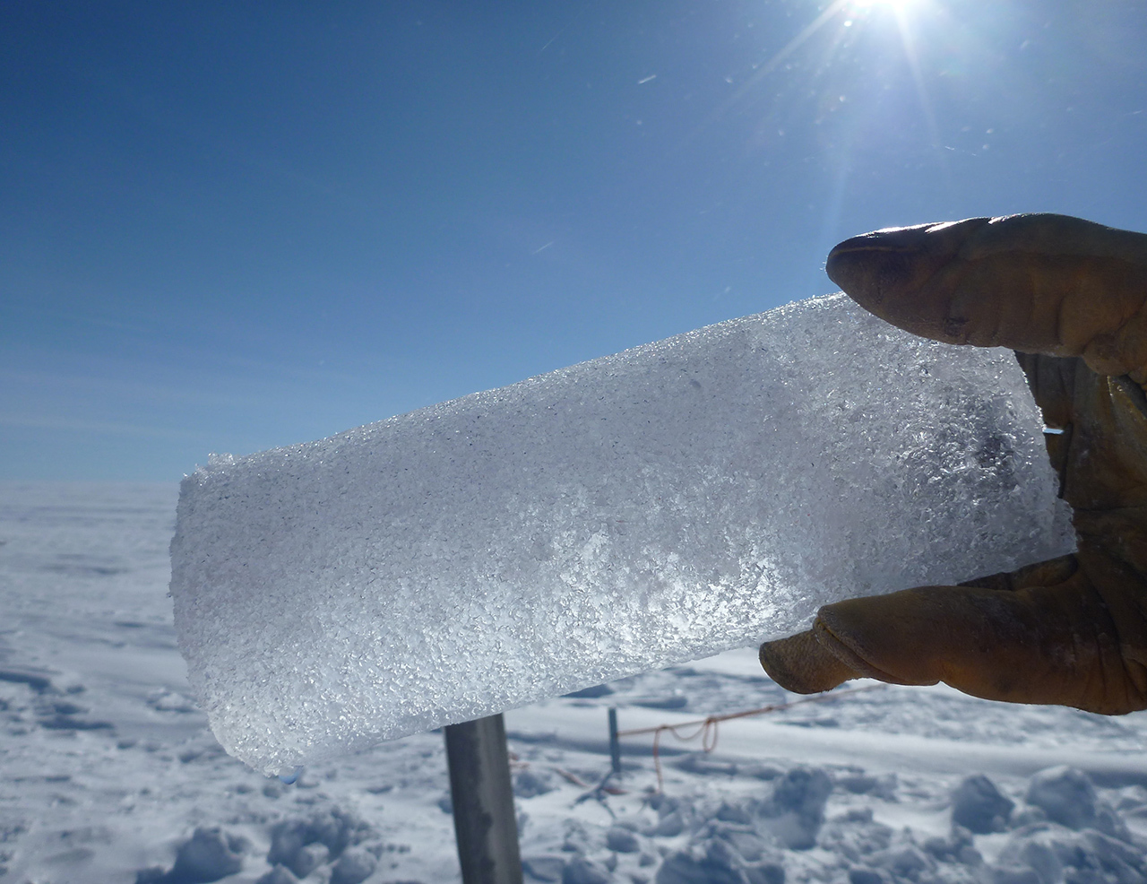

CO₂ Measurements
Ice cores (100’000s years ago)
Ice cores preserve past atmospheric CO₂ in air bubbles trapped as snow compacts into ice, providing a direct record of past atmospheres.
These records extend back ~800,000 years, allowing long-term CO₂–climate relationships to be studied.
Temporal resolution decreases with depth as ice flow and firn diffusion smooth the signal, averaging CO₂ over longer time periods.

Slide 29
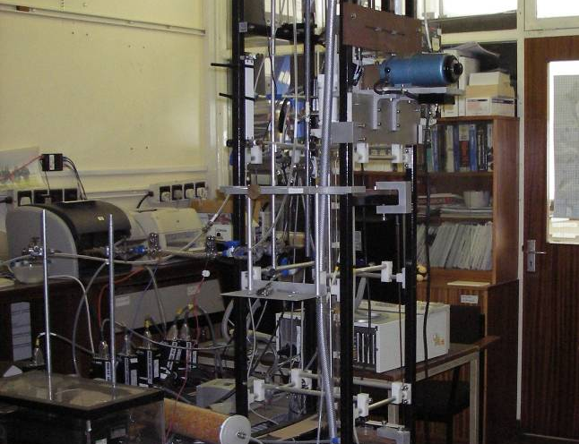
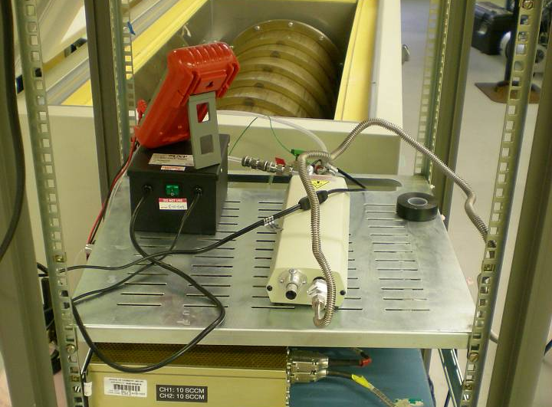
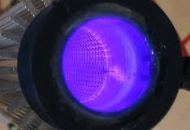
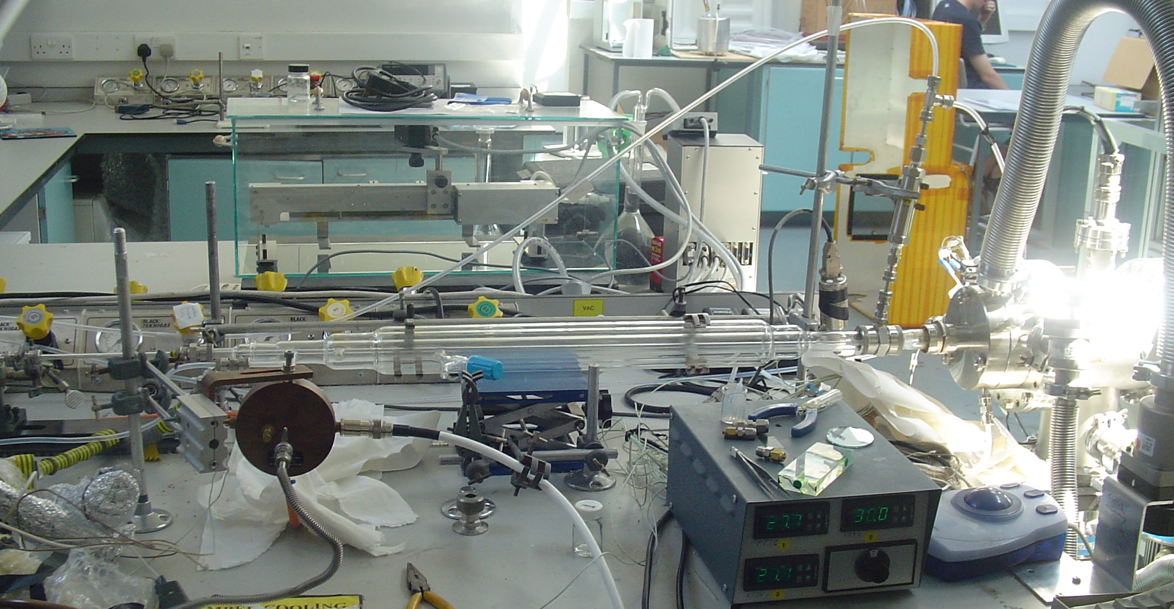
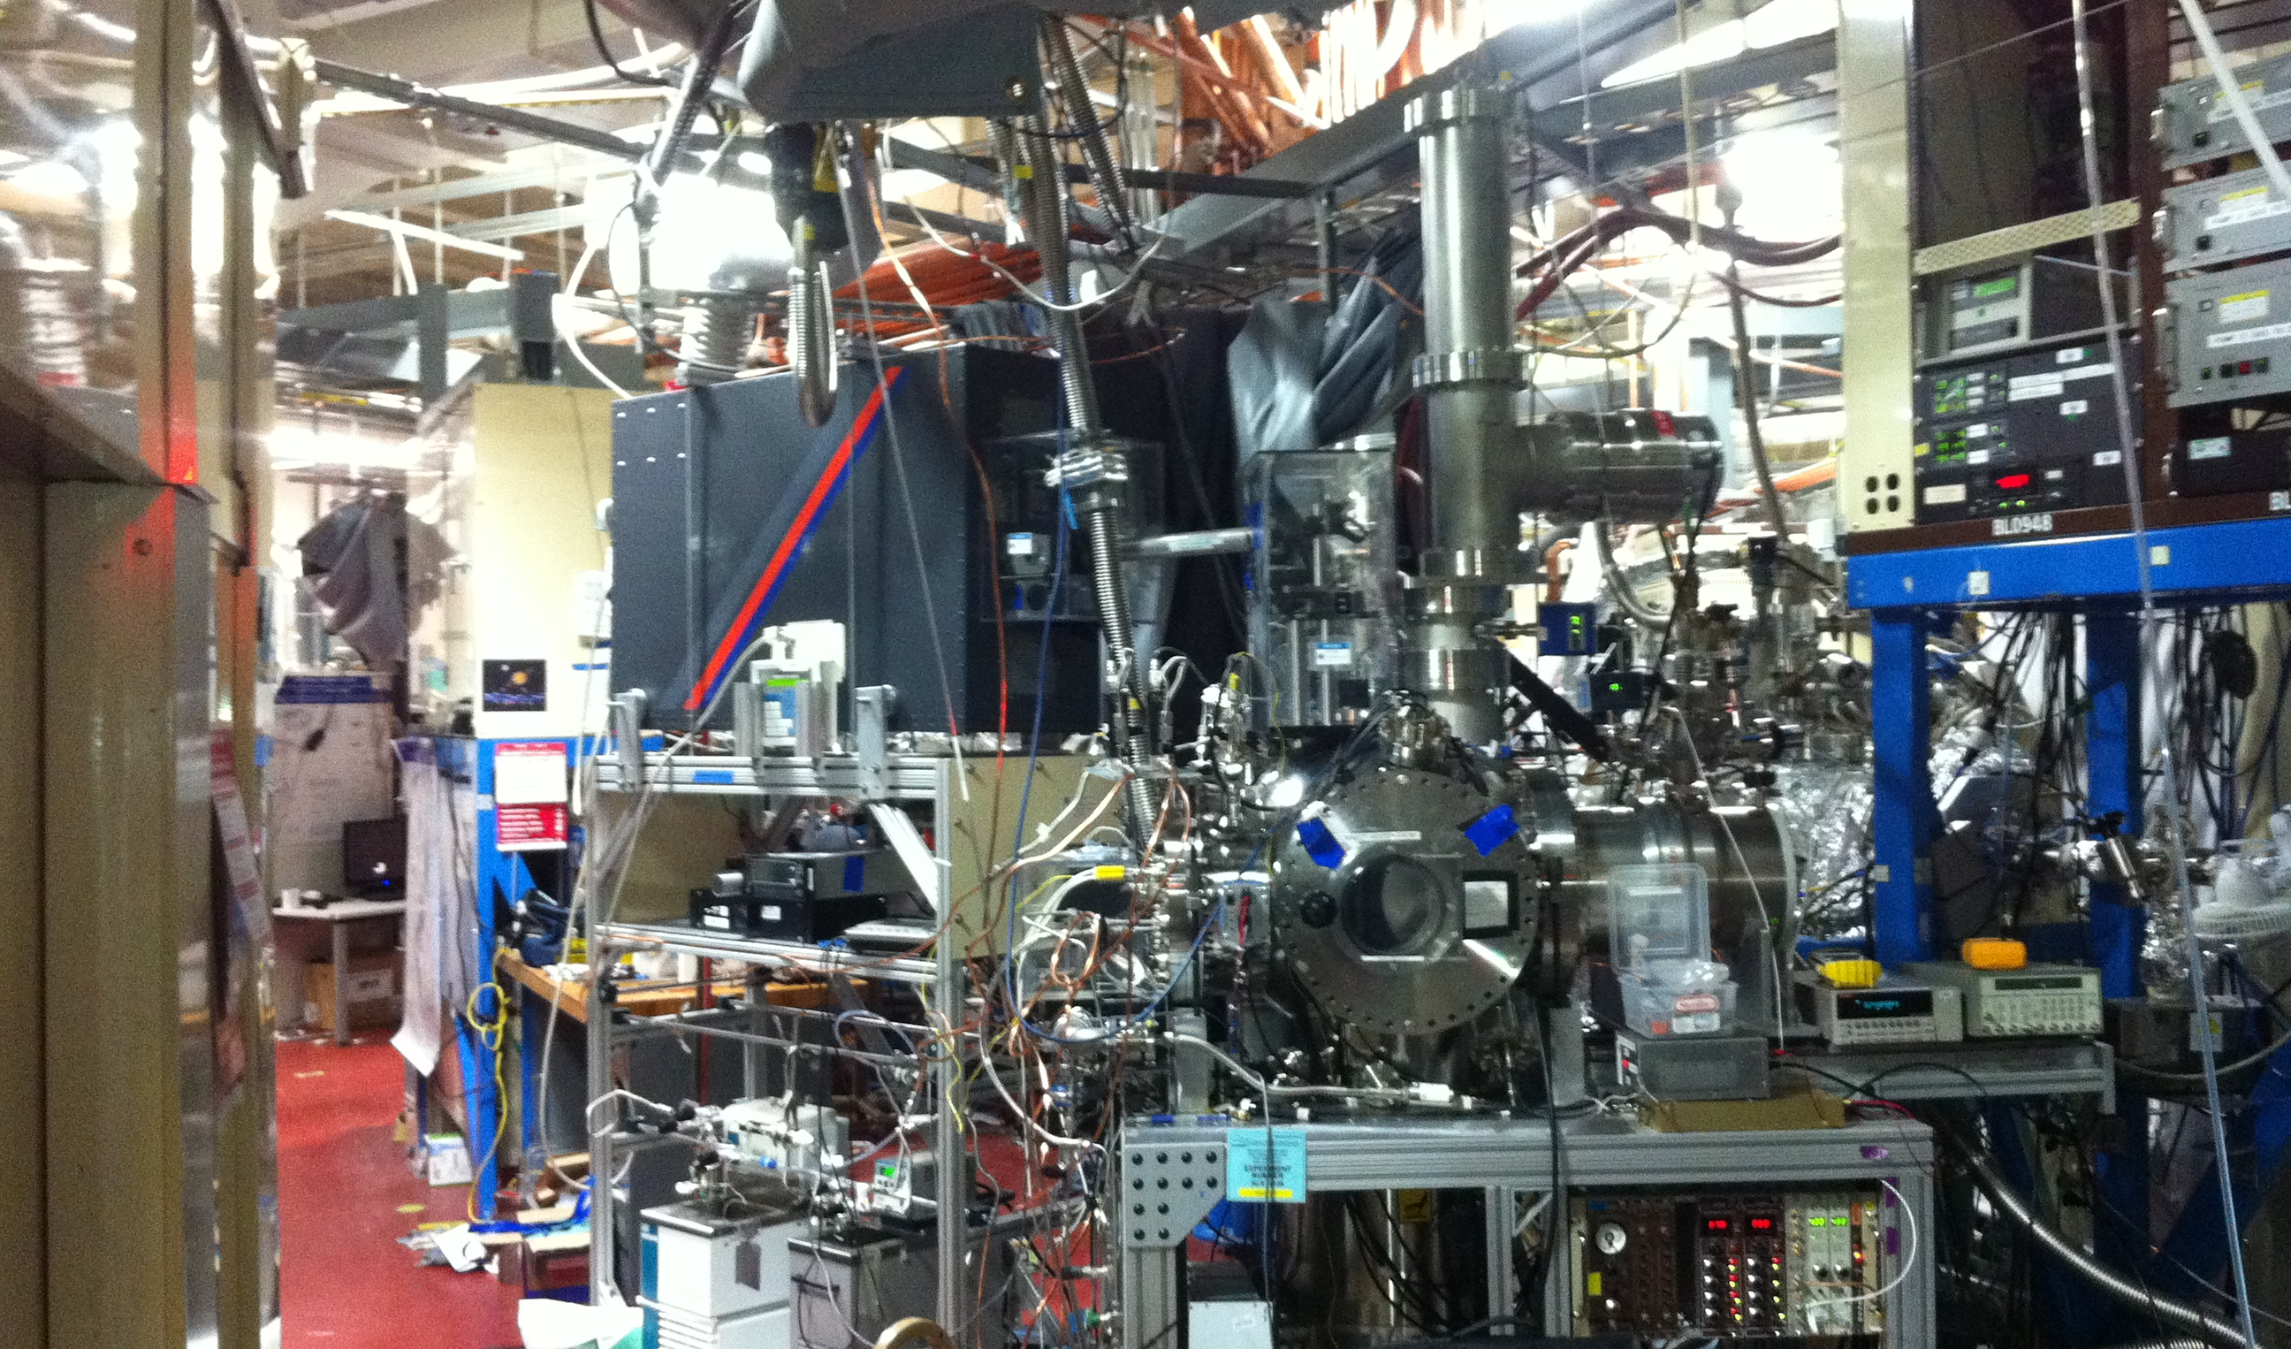
Laboratory studies of gas kinetic reactions

Slide 30
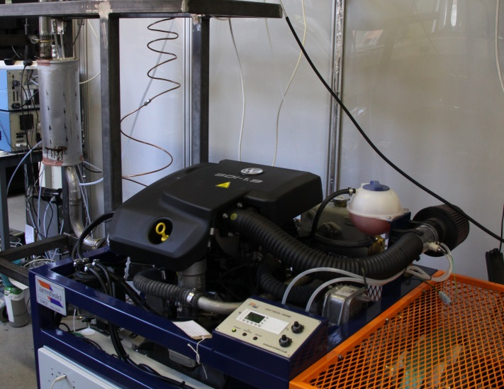
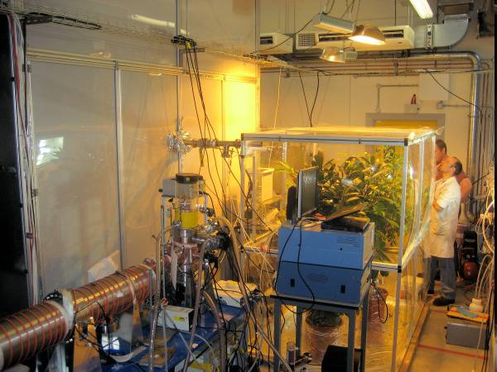
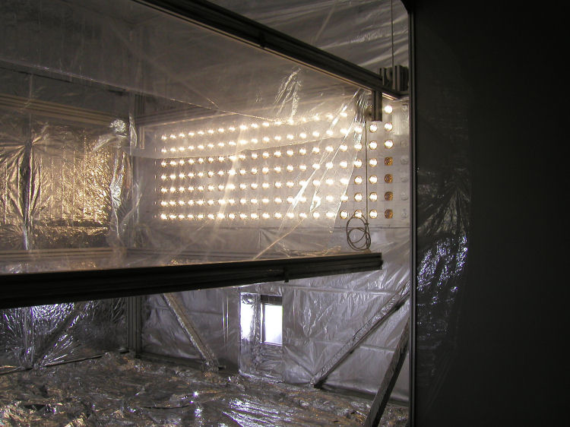
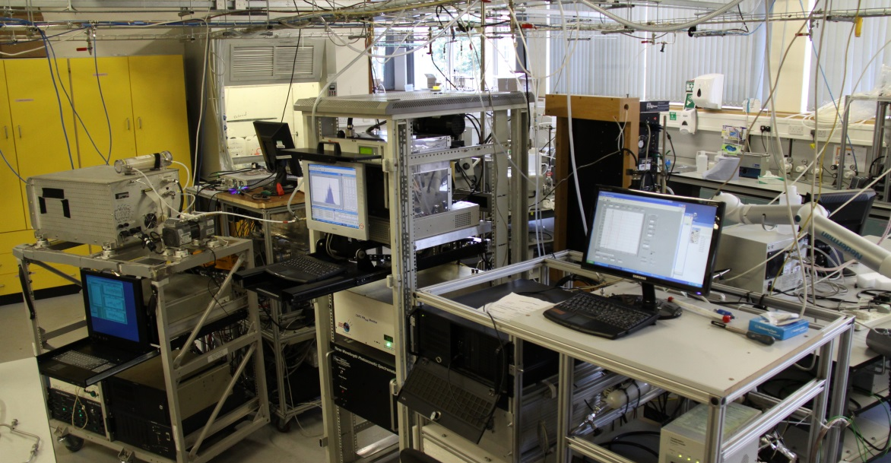
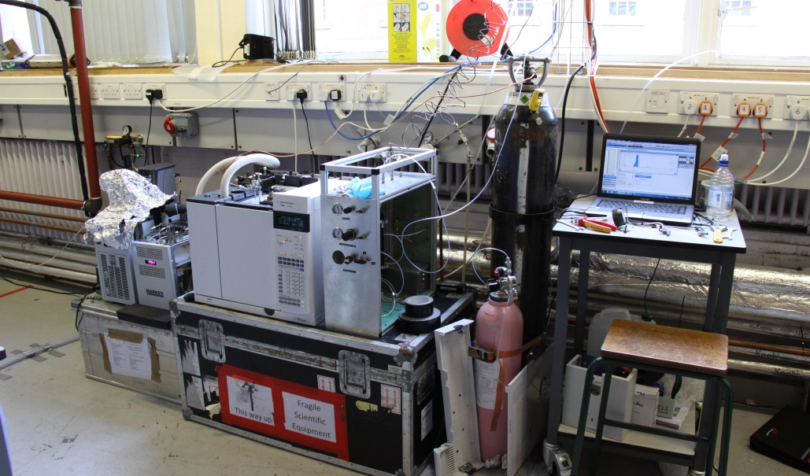
Photochemical chamber studies of coupled processes in real systems

Slide 31

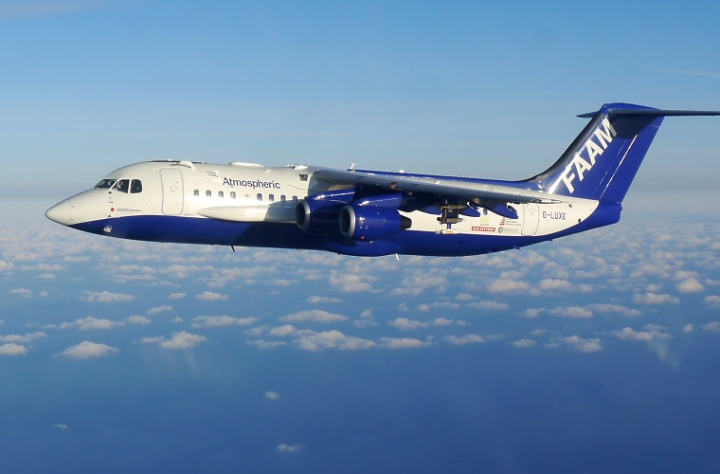
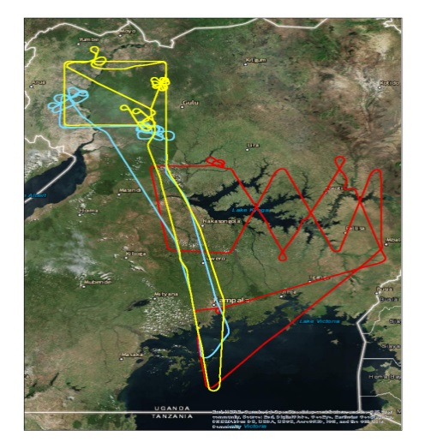
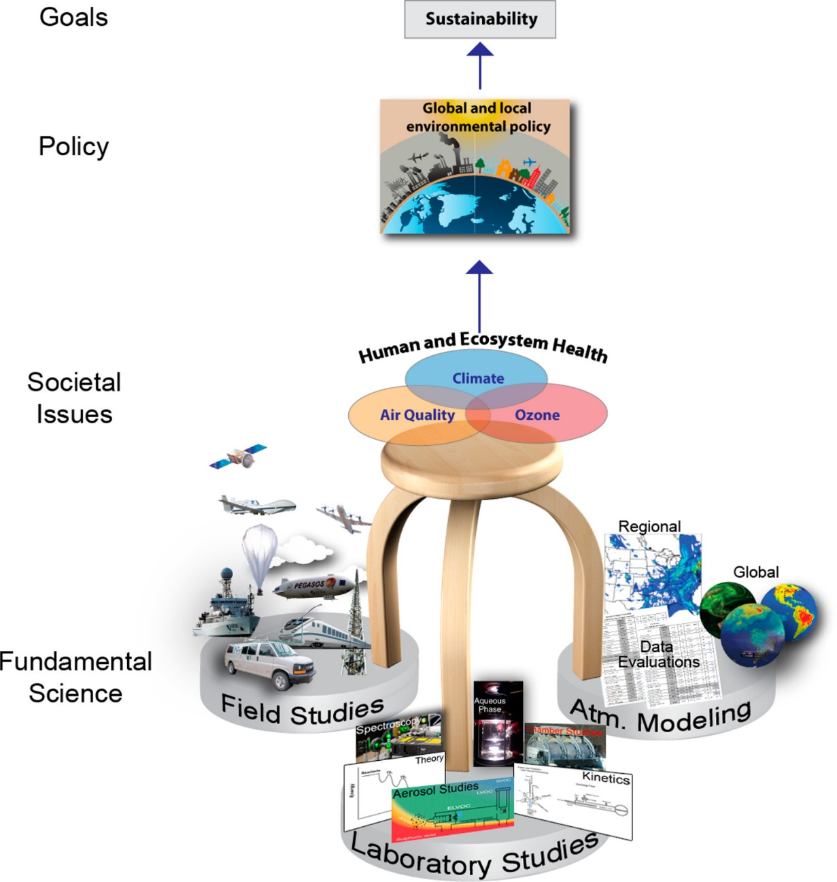
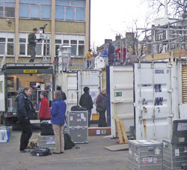
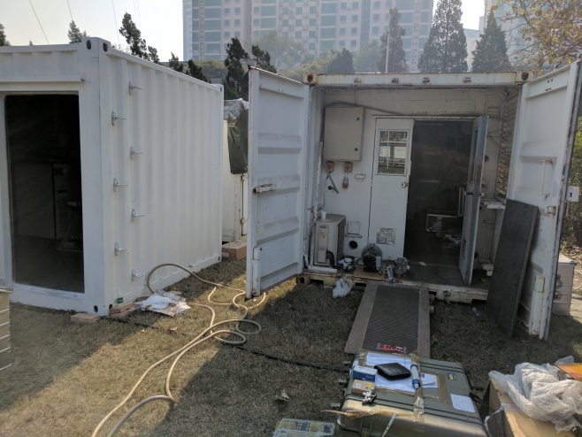


Slide 32

Collaborative airborne studies of emissions
WEEK 5 and 9

Slide 33
Atmospheric Composition
Constituent | Mole Fraction
N₂ | 0.781
O₂ | 0.209
Ar | 0.0093
CO₂ | 0.0004
H₂O | 0 – 0.04
CH₄ | 1700 ppb
H₂ | 550 ppb
N₂O | 320 ppb
CO | 40 – 200 ppb
O₃ | 20 – 80 ppb
C₂H₆ | 1 ppb
SO₂ | 0.1 ppb
Kr | 1.1 ppm
NO₂ | 20 ppb

Slide 34

Atmospheric Composition

Slide 35

Understanding Units
Units:
For Particulates (e.g., PM): Micrograms per Cubic Meter (µg/m³).
For Gases: Parts per Million (ppm), Parts per Billion (ppb), Parts per Trillion (ppt).
Explanation:
Micrograms per Cubic Meter (µg/m³): Measures the mass of particulate pollutants in micrograms (one-millionth of a gram) per cubic meter of air. For example, a concentration of 43 µg/m³ signifies the presence of 43 micrograms of a pollutant in each cubic meter of air.
Parts per Million (ppm): Indicates the number of units of mass of a gaseous pollutant per one million units of the total mass of the air.
Parts per Billion (ppb): Represents the number of units of mass of a pollutant per one billion units of the total mass of the air.
Parts per Trillion (ppt): Denotes the number of units of mass of a pollutant per one trillion units of the total mass of the air.
Understanding these concentration units is vital for evaluating air quality, monitoring pollutant levels, and assessing the environmental and health impacts of pollutants within the atmosphere.

Slide 36


Anthropogenic Climate Change
WEEK 4
Figure SPM.1, AR5 Synthesis Report

Slide 37

Anthropogenic Climate Change
Figure SPM.1, AR5 Synthesis Report

Slide 38

Modelling Anthropogenic Impacts
The following protocol is typical.
1. A GCM model is run for many decades with no external forcing
2. The statistics of the run (mean climate, annual cycles and variability on a range of time scales) are then compared with observation to assess performance.
3. The model is then re-run with changes in forcing (such as greenhouse radiative forcing).
4. The difference in the two climates provides an estimate of the consequent climate change arising form that forcing factor.
WEEK 6

Slide 39


Anthropogenic Climate Change
WEEK 6
Figure 1.1, AR5 Synthesis Report

Slide 40

Global Mean Temperatures

Slide 41

Indicators of GCC: Changes in Extreme Temperature
The Bell curve shows how an increase in average temperatures will lead to an increase in hot and extreme weather. Note - this does not mean there will be “no more” cold weather: cold events will become rarer but will not disappear. Source: US Climate Change Science Program

Slide 42



Indicators of GCC: Cryosphere
Snow and glaciers
Sea ice
Ice loss
Figure TS.1, AR5 Technical Summary Report

Slide 43



Indicators of GCC: Ocean
50%
40%
10%
Land water storage
Table 13.1, AR5 Full report, gives a full breakdown of each component

Slide 44


Indicators of GCC: Ocean
Ocean acidification is a consequence of increasing carbon dioxide (CO₂) emissions
When CO₂ dissolves in seawater, it forms carbonic acid (H₂CO₃)
Acidity plays a key role in many biological mechanisms, including calcification.
Ocean acidification impacts both small coastal communities and big industries. By harming aquaculture and tourism, communities that rely on the ocean as a source of food and income will be particularly affected.

Slide 45


Indicators of GCC: Precipitation
WEEK 9

Slide 46
Indicators of GCC: Changes in Extreme Precipitation and Droughts
Increased temperatures
Air can hold more water vapour
More intense hydrological cycle
More evaporation
More droughts
More water within storms
More extreme precipitation
Sea-level rise
More flooding

Slide 47

Indicators of GCC: Extreme Weather Events
Number of reported weather-related disasters have increased by a factor of 5
WMO Atlas of Mortality and Economic Losses from Weather, Climate and Water Extremes (1970–2019)

Slide 48


Unprecedented changes?
Figure SPM.1, AR6 Summary for Policymakers Report

Slide 49

WEEK 8

Slide 50

Future projections
WEEK 9

Slide 51

Humans are now considering engineering their climate
WEEK 10
Afforestation Bioenergy with carbon capture
Biochar production and burial
Soil carbon enrichment
Ocean iron fertilisation (OIF)
Enhanced weathering and ocean alkalinisation
Space mirrors
Stratospheric aerosol injection (SAI)
Cirrus cloud thinning (CCT)
Marine sky brightening (MSB)
Surface-based brightening
Direct air CO₂ capture and storage (DACCS)
Lawrence et al., 2018, Nature Communications

Slide 52
Today’s Lecture Summary
Human Activities as Drivers: Human activities, including fossil fuel combustion, land-use changes, and industrial processes, are the primary drivers of greenhouse gas emissions.
CO₂: Carbon dioxide (CO₂) is the most significant greenhouse gas emitted due to human activities, with other contributors like methane (CH₄) and nitrous oxide (N₂O) also playing major roles.
Non-CO₂ Influences: Short-lived climate forcers such as aerosols, black carbon, and methane have complex and varied climate impacts.
Trends in Emissions: Emissions of CO₂, CH₄, and other greenhouse gases have risen sharply over the past century, with future pathways depending on mitigation efforts.
Atmospheric Concentrations: Greenhouse gas concentrations have significantly increased since pre-industrial times, with CO₂ levels now at their highest in millions of years.
Radiative Forcing: Anthropogenic activities are the primary source of positive radiative forcing, which is driving global warming. Aerosols contribute a negative forcing, partially offsetting warming.
Future Projections: Without significant mitigation, global temperatures are projected to rise well beyond 1.5°C and 2°C, leading to severe climate impacts.
Regional Climate Change: The effects of global warming, such as temperature changes, sea level rise, and altered precipitation patterns, will vary regionally but will universally affect ecosystems and human systems.
Climatic Impact Drivers: Key impacts include changes in temperature and precipitation patterns, leading to extreme events, biodiversity loss, and threats to food and water security.

Slide 53
Intended Learning Outcomes
Hopefully now you will be able to:
Understand Climate Change Basics: Define and explain the key components of climate change, including the role of greenhouse gases, aerosols, and human activities.
Climate Change Impacts: Analyse how changes in climate influence weather extremes, such as heatwaves, droughts, and heavy precipitation.
Air Quality and Climate Interaction: Evaluate the relationship between air pollution and global climate change, including their impacts on health and ecosystems.

Slide 54
What could I ask you in an exam?
Define greenhouse gases and explain their role in global warming.
What are aerosols, and how do they influence the Earth's climate?
How does air pollution exacerbate the effects of climate change?
Explain the term "radiative forcing" and its relevance to climate science.
Describe how heatwaves influence the severity of air pollution.
Using examples, explain the difference between short-lived and long-lived climate forcers.
Analyse the role of anthropogenic activities in increasing the frequency of extreme weather events.
Interpret a graph showing CO₂ concentrations over the past century and discuss its implications.
Identify the main contributors to current warming trends.
If a country implements policies to reduce methane emissions, what immediate climate benefits might result?
Propose a strategy to simultaneously improve air quality and combat climate change.
How do deforestation and land-use changes contribute to global climate change?
Describe the feedback mechanisms in the climate system, such as the ice-albedo effect and the water vapour feedback.
Discuss the significance of the 1.5°C and 2°C warming thresholds for global climate policy and impacts.
Examine how global climate models (GCMs) are used to project future climate scenarios and their limitations.

Slide 55
Next Week: Natural Climate Variability
In next week’s lecture, you will learn:
What natural climate variability is, and how it differs from human-driven climate change.
What causes climate to change naturally, including Earth’s orbit, the Sun, volcanoes, and the oceans.
How Milankovitch cycles (changes in Earth’s orbit and tilt) work, and how they can lead to ice ages and warmer periods.
How solar activity and volcanic eruptions affect climate, and how long their impacts usually last.
What El Niño and La Niña (ENSO) are, and how they influence weather and climate around the world.
How evidence from past climates (e.g. ice cores) helps us understand natural climate change and put today’s changes into context.

Slide 56


Feedback

Slide 57


Thank you
Thomas.Bannan@Manchester.ac.uk

